Slide 1
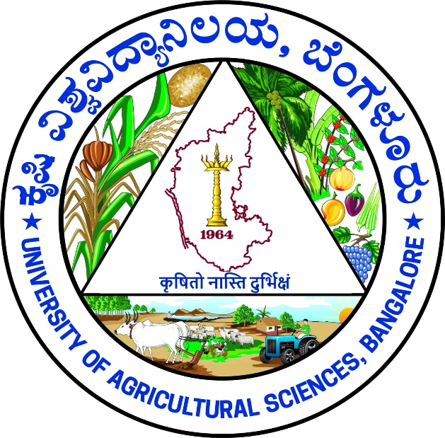
Application of Artificial Intelligence and Machine Learning for Crop Yield Prediction and Fertilizer Optimization in Fodder Sorghum (Sorghum bicolor)
UNIVERSITY OF AGRICULTURAL SCIENCES ,
COLLEGE OF AGRICULTURE,
GKVK, BANGLORE
Student group details
AMB2213: P RAVINDRA REDDY
BMB2045:RATHAN N GOWDA

Slide 2
Content
Introduction
Problem Statement
Motivation
Objectives of the project
Dataset Overview
Methodlogy/approach
Tools and Technologies Used
Results
Discussion / Analysis
Conclusion and Future Work
References/Acknowledgements

Slide 3
Introduction
Indian agriculture feeds over 1.4 billion people but suffers from low productivity and climate vulnerability Fodder production is underfunded despite livestock contributing ~26% to agricultural GDP Fodder availability is the key constraint limiting livestock productivity Nitrogen (N) and Phosphorus (P) are critical for biomass and dry matter yield in fodder crops Fertilizer use is often unscientific, causing overuse (environmental harm) or underuse (25–40% yield gaps)

Slide 4
Problem Statement
Gap exists between AI research and real-world adoption in agriculture Limited use of AI/ML specifically for fodder crop nutrient optimization No validated model for N–P optimization in fodder sorghum Lack of solutions tailored to Eastern Dry Zone of Karnataka conditions Project integrates field experiments (RCBD) with ML model development and deployment

Slide 5
Motivation
Fodder shortage reduces livestock productivity and farmer income Improper fertilizer use causes yield loss and environmental damage Optimizing N–P improves fodder yield and resource efficiency Helps farmers adopt precision and climate-smart agriculture Bridges gap between AI research and real farm applications Provides region-specific, data-driven solutions for better

Slide 6
Objectives of the Project
Develop ML model to predict growth and fodder yield with ≥85% accuracy (R² ≥ 0.85) Use inputs like N–P levels, soil properties, and environmental factors Build AI system to recommend optimal fertilizer dose (50–200% RDNP) Validate recommendations using RCBD field experiment (Rabi 2024) Design integrated system with IoT sensors, cloud ML, and advisory interface Compare the ML Models for crop yield production in Agriculture

Slide 7
Dataset Overview
Source of Data
Primary data collected from Rabi 2024 field experiment (RCBD design) at GKVK, Bengaluru Dataset Size 21 plots with 3 replications 63 growth observations + 21 yield observations Secondary & Augmented Data 1200+ historical records (ICAR data) 500 synthetic samples added using bootstrapping Input Features Fertilizer levels (N & P), plant height, leaf count, soil type, rainfall, temperature, NDVI Target Variable Fodder yield (kg per plot)

Slide 8
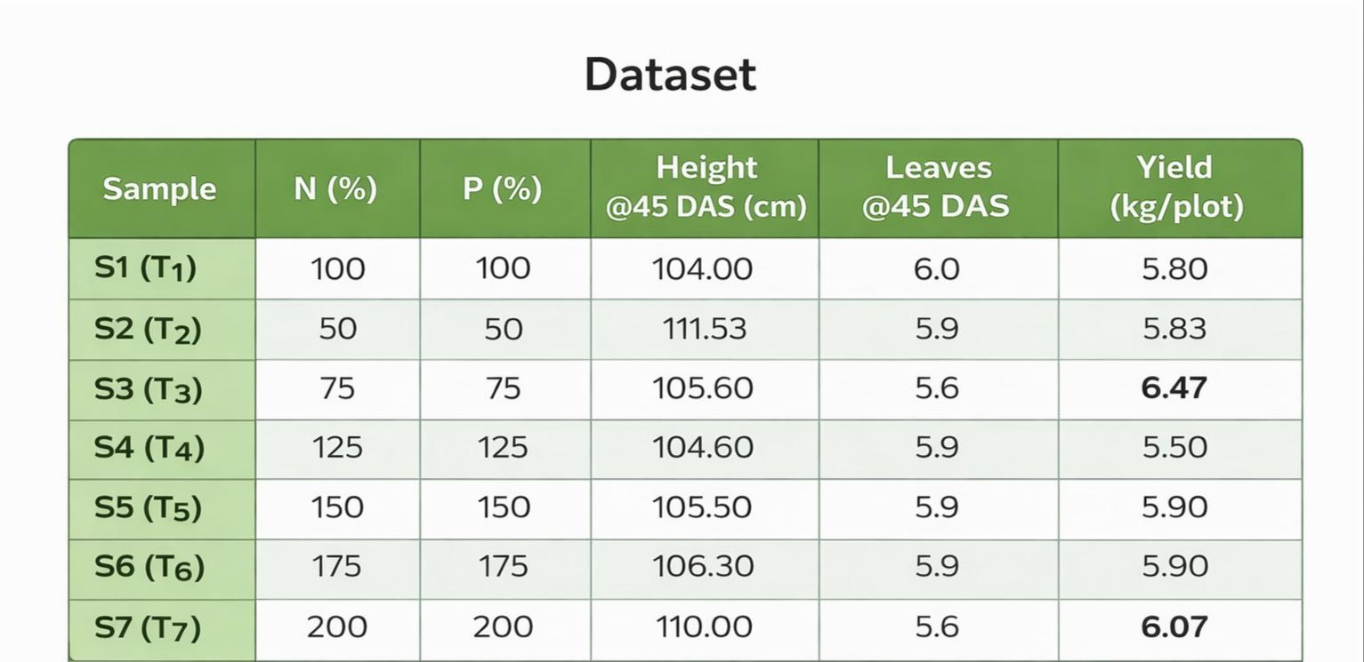
Dataset

Slide 9
Methodology / Approach
Data Cleaning & Preprocessing Handling missing values, removing outliers, and normalizing data for better model performance Exploratory Data Analysis (EDA) Understanding data patterns, relationships, and distributions using visualizations Model / Algorithm Selection Choosing suitable models like Linear Regression, Decision Tree, Random Forest, SVM, CNN-LSTM Model Training & Validation Splitting data into training and testing sets to evaluate model performance Evaluation Metrics Accuracy F1-Score Confusion Matrix Silhouette Score (for clustering)

Slide 10
Tools and Technologies Used
Libraries Used Pandas – Data manipulation and analysis NumPy – Numerical computations Scikit-learn – Machine learning models Matplotlib – Data visualization Development Environment Jupyter Notebook – Interactive coding & visualization Google Colab – Cloud-based execution with GPU support

Slide 11
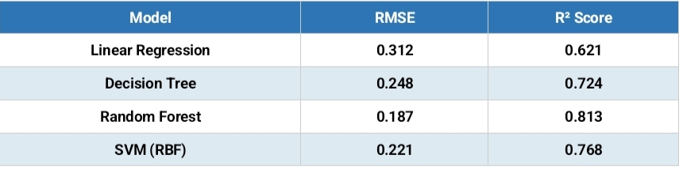
RESULTS

Slide 12
Discussion / Analysis
Optimal fertilizer levels identified at 75% and 175% RDNP Dataset limitations handled using augmentation techniques Challenges included small dataset size and data variability Model performance depends on quality of input features Helps in precision farming and better fertilizer decision-making

Slide 13
Conclusion and Future Work
Developed an AI/ML system for crop yield prediction and fertilizer optimization. Performance can improve with more real-world data and advanced models Future scope includes real-time systems using IoT and sensor integration Practical application in precision farming and smart agricultural decision-making Gained hands-on experience in data analysis, ML modeling, and problem-solving

Slide 14
References / Acknowledgements
Liu, J. Et al. (2023) – Deep Reinforcement Learning for Nitrogen Management in Agriculture Jones, J.W. Et al. (2023) – Digital Twins for Crop Systems MarketsandMarkets (2023) – AI in Agriculture Market Forecast Report Shekara, B.G. Et al. (2022) – ML-Based Fertilizer Optimization in Sugarcane Zhu, Y. Et al. (2021) – LSTM-Based Crop Yield Prediction Balaji, M. & Arunachalam, T. (2021) – IoT-Based Smart Agriculture System Van Klompenburg, T. Et al. (2020) – ML for Crop Yield Prediction (Review) Talaviya, T. Et al. (2020) – IoT Applications in Agriculture Khaki, S. & Wang, L. (2019) – Deep Learning for Crop Yield Prediction Pantazi, X.E. Et al. (2016) – Machine Learning in Precision Agriculture

